Slide 1
Does your approach to delivery matter? An Update on Publication Strategies
Innovations in Testing Conference
San Antonio, TX
February 2018

Slide 2
Presenters
Liberty J. Munson, PhD
Microsoft Worldwide Learning
Principle Psychometrician
Russ Smith, Ph.D.
Laura Balk
Alpine Testing Solutions
CompTIA
VP Assessment Services, Senior Psychometrician
Director, Exam Development Services

Slide 3
Innovating and experimenting with publication: Microsoft’s Journey
Liberty Munson

Slide 4
An Overview of MS Certification Exams
Computer administered
Test center deliveries or online proctoring
Global distribution
Ongoing delivery
Variety of item types (e.g., multiple choice, drag and drop, active screen, hot area, case studies, labs, text entry, code analysis, etc.)

Slide 5
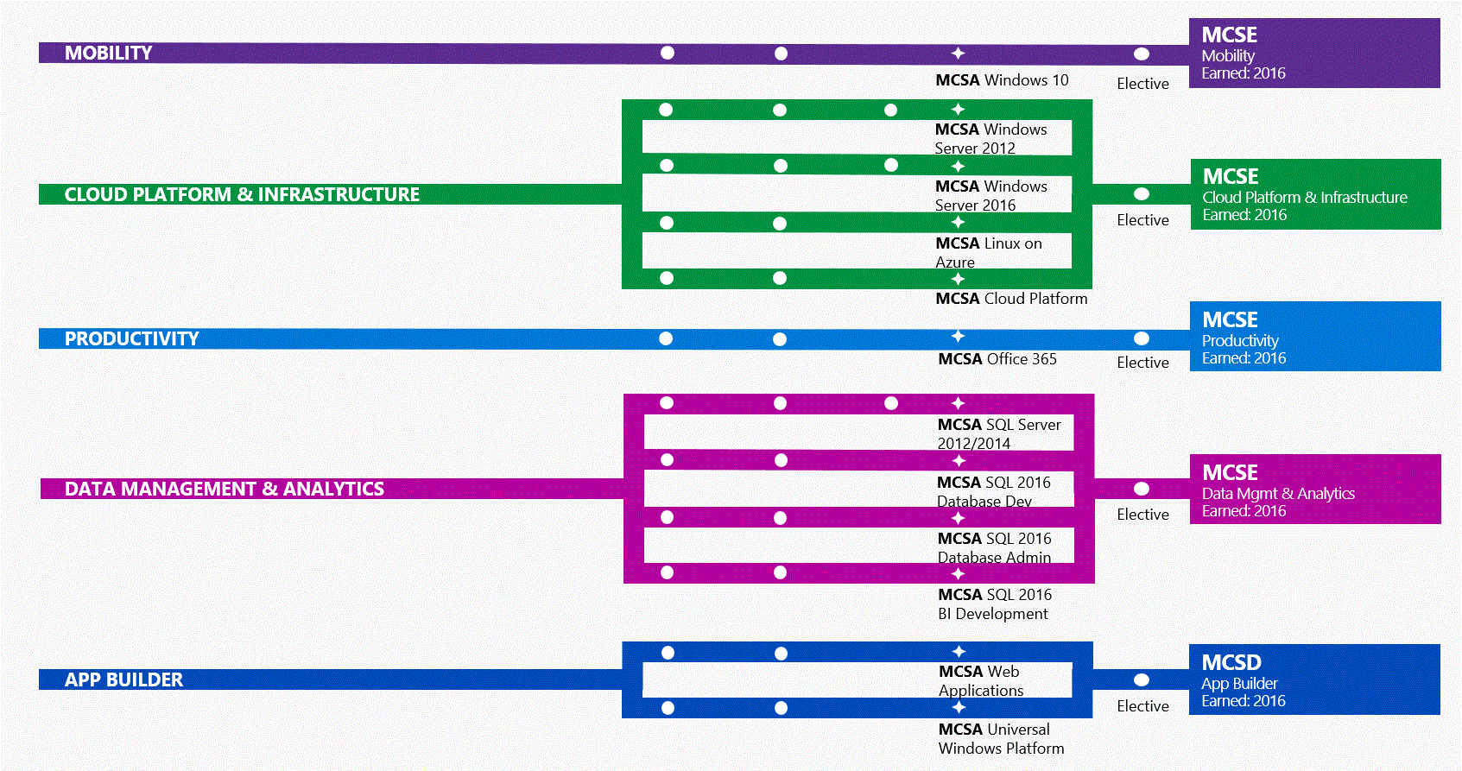
Microsoft Learning Experiences
Drive adoption of Microsoft technologies through training and certification
Notes:
MCSE: Cloud Platform and Infrastructure – focusing on skills validation for Windows Server and Microsoft Azure
MCSE: Mobility – focusing on skills validation for Windows Client and Enterprise Mobility Suite
MCSE: Data Management and Analysis – focusing on skills validation for both on-premises and cloud-based Microsoft data products and services
MCSE: Productivity – focusing on skills validation for Office 365, SharePoint, Exchange, and Skype for Business
MCSD: App Builder – focusing on skills validation for Web and Mobile app development
MCSE: Business Applications – focusing on skills validation for Dynamics AX and Dynamics 365

Slide 6
CLOUD PLATFORM & INFRASTRUCTURE PATH
410:
Installing and Configuring
Windows Server 2012
411:
Administering
Windows Server 2012
412:
Configuring Advanced
Windows Server 2012
Services
MCSA Windows
Server 2012
740:
Installation, Storage, and
Compute with
Windows Server 2016
741:
Networking with
Windows Server 2016
742:
Identity with
Windows Server 2016
MCSA Windows Server 2016
CLOUD PLATFORM & INFRASTRUCTURE
MCSE
Cloud Platform & Infrastructure
Earned: 2017
Elective
533: Managing
Microsoft Azure
Infrastructure Solutions
LFCS:
Linux Foundation
Certified System Administrator
MCSA Linux on
Azure
Elective Exam Pool
(January 2017)
532: Developing Microsoft Azure Solutions
533: Managing Microsoft Azure Infrastructure Solutions
534: Architecting Microsoft Azure Solutions
473: Designing and Implementing Cloud Data Platform Solutions
475: Designing and Implementing Big Data Analytics Solutions
744: Securing Windows Server 2016
413: Designing and Implementing a Server Infrastructure
414: Implementing an Advanced Server Infrastructure
246: Monitoring and Operating a Private Cloud
247: Configuring and Deploying a Private Cloud
Choose two from:
532: Developing Microsoft Azure Solutions
533: Managing Microsoft Azure Infrastructure Solutions
534: Architecting Microsoft Azure Solutions
473: Designing and Implementing Cloud Data Platform Solutions
475: Designing and Implementing Big Data Analytics Solutions
MCSA Cloud Platform

Slide 7
Renewing Certifications & Retaking Exams
Certifications include achievement date
  Signifies investment in staying up to date on the technology
  Every year, they can re-earn their MCSE certification by passing an additional exam from the list of electives
  Option to retake exams where technology is rapidly changing either to renew their MCSE or to simply show currency in the technology

Slide 8
Defining Publication Strategies
Continuous publication
Dynamic Forms Assembly
Selecting items or predefined testlets from a pool with specific consideration of item’s psychometric properties and alignment to blueprint
Forms are dynamically generated
Republishing fixed forms at regular intervals (e.g., monthly)
Forms are balanced psychometrically but each publication contains only a subset of item pool and different combinations of items define each form at each publication
Adaptive Forms Assembly
Selecting items on the fly during delivery based on the candidates estimated skill level (theta)
Microsoft doesn’t currently deliver exams using this strategy (but I see it on the horizon!)
Why? Very high candidate dissatisfaction

Slide 9
Continuous Republication
Why?
Items on forms change every few weeks
Candidates using inappropriate test taking preparation methods don’t know what to expect
May limit value of brain dump sites
When?
Large item pools with known psychometric properties
Available resources
Time consuming depending on publication process
Costly

Slide 10
Dynamic Forms Assembly
Why?
Minimize exposure of item pool
With a large enough item pool, candidates see different combinations of items with every delivery
When?
Large item pools
Item psychometric (IRT) properties are known
Candidates using inappropriate test taking preparation methods don’t know what to expect
May limit value of brain dump sites
For MS, this takes fewer internal resources and may be less costly than continuous publication (oddly enough)

Slide 11
Dynamic Forms Assembly—What you need
Very large item pool
Recommendations vary on size and depend on the targeted test length
Delivery provider will need:
List of items in the pool
Content attributes for each item
IRT item parameters for each item
Lists of enemy items that should not be presented together
Blueprint with upper and lower acceptable bounds for each content area
List of exposure control parameters for each item
Target test length

Slide 12

Preparing to Deliver Dynamic Exams
Understand delivery capabilities
What models are supported?
  Rasch, 3PL
What information do you need to provide for delivery?
  List of viable items
  Appropriate statistics
  Blueprint requirements: Number of items per content area
  Cut score theta
  Number of items to be delivered
How are item sets (e.g., cases), item enemies, polytomously scored items handled?
When does the exam end?
How does scoring work? What will be reported back in the data you receive from EDP?
  Are you expecting raw scores or thetas?

Slide 13

Pilot Test & Evaluate
Is scoring algorithm working as expected?
Are polytomously scored items being scored correctly?
How closely is the actual delivery aligning to the parameters provided?
Validate correct item measures are used
Rescore candidates with proper item measures and scoring and compare to what’s obtained from test candidate data
  How much error is acceptable?

Slide 14
Observations and Outcomes
Took much longer to implement than expected
Because early results revealed problems with scoring, evaluated test runs for all exams that would be delivered dynamically
We have data, but it took more time than expected!
BUT, we will realize cost savings and this will require fewer resources

Slide 15
Is/Was this a good Idea?
Let’s find out…

Slide 16

LOFT: Simulation vs. Empirical
Simulation
  224 items
  10,000 simulated administrations
  Included 1, 2, 3, and 4-point items
  55 points selected
  Points fixed at 61
  BP was matched exactly
Empirical
  Retired exam
  335 items
  3,030 administrations
  Included 1, 2, and 3-point items
  55 items selected
  Points varied from 55 to 61
  BP was within a 3-point tolerance
What about the comparability of the test taking experience?
Is it fair?

Slide 17

Simulation
Empirical
If these three forms were fixed, the expected average times would be:
44 minutes,
55 minutes, and
67 minutes.

Slide 18
Simulation
Empirical
If these three forms were fixed, the expected cut score would be:
43.5%,
53.0%, and
62.5%.

Slide 19
 | Empirical |  |  | Simulated |  |  | Fixed
 | Least Reliable | Average Reliability | Most Reliable | Least Reliable | Average Reliability | Most Reliable | Form A | Form B
Mean | 31.13 | 33.14 | 31.52 | 31.87 | 34.51 | 40.60 | 31.10 | 30.55
Standard Deviation | 7.69 | 9.39 | 10.81 | 4.53 | 5.99 | 7.61 | 8.44 | 8.89
Reliability | 0.82 | 0.89 | 0.92 | 0.64 | 0.79 | 0.87 | 0.87 | 0.89
 | Empirical |  |  | Simulated |  |  | Fixed
Reliability | 0.82 | 0.89 | 0.92 | 0.64 | 0.79 | 0.87 | 0.87 | 0.89
 | Empirical |  |  | Simulated
Reliability | 0.82 | 0.89 | 0.92 | 0.64 | 0.79 | 0.87 | 0.87 | 0.89
 | Empirical
Reliability | 0.82 | 0.89 | 0.92 | 0.64 | 0.79 | 0.87 | 0.87 | 0.89
The empirical reliability delta is not as extreme as was simulated last year, but still much greater than fixed forms.

Slide 20
There’s more variability in the random administration.

Slide 21
Besides a handful of candidates skipping through the exam, there’s not a big difference in the bivariate score by time relationship.

Slide 22
LOFT/Dynamic Forms
Advantages
  Time to market
  Cost
Disadvantages
  Inconsistent test taking experience for the candidates
  Potential fairness issues

Slide 23

Dynamic Forms: A balancing act
Cost/business constraints
Cost/business constraints
Tolerance for variation in administrations
Tolerance for variation in administrations
Number of constraints
Number of constraints
Size of the item bank
Size of the item bank
Size of the item bank
Nefarious Test Takers

Slide 24
Size of the bank
4.0%
5.5%

Slide 25
Size of the bank
4.0%
5.5%

Slide 26
Size of the bank

Slide 27
Size of the bank
As bank size increases* the percent of candidates with pre-knowledge decreases.
*relative to the number of admins and number of items administered

Slide 29
About the presenter
Liberty J. Munson
Microsoft Worldwide Learning
Principal Psychometrician for Microsoft’s Learning & Readiness organization
Responsible for ensuring that the skills assessments in Microsoft Technical Certification and Professional Programs are valid and reliable
Prior to Microsoft, worked at Boeing in their Employee Selection Group, assisted with the development of their internal certification exams, and acted as a co-project manager of Boeing’s Employee Survey
BS in Psychology from Iowa State University and MA and PhD in Industrial/Organizational Psychology with minors in Quantitative Psychology and Human Resource Management from the University of Illinois at Urbana-Champaign

Slide 30
About the presenter
Russ Smith
  VP Assessment Services
  Senior Psychometrician
Conducting and overseeing the quality of test development and psychometric analyses
Research interests: psychometric security analyses, standard setting approaches, and automated test assembly algorithms
Previously a senior psychometrician at Galton Technologies and Prometric, co-authored a chapter in the Handbook of Test Development
Ph.D. from the University of Nebraska – Lincoln

