Slide 1
Starting a Performance Based Testing Program:
From Inception to Delivery

Slide 2
We are a non-profit trade association advancing the global interests of IT professionals and companies.
Certification- We are the leading provider of technology neutral and vendor neutral IT certifications.
21 Certification programs in the IT space; 4 of which have performance based items.

Slide 3
Why Performance Based Items?
Our customers are demanding it.
We have the resources and bandwidth to do it.
Differentiate in the marketplace.
“It looks cool.”
More reasons to come later…..
Notes:
Face validity- our tests look like it is going to measure what it is supposed to measure.

Slide 4
The “Why” for CompTIA
More appropriately validates skills and knowledge areas on our certifications.
Higher level objectives that are critical to the certification job role are challenging to test with text based items.
Align with real-world job situations
Keep up with IT industry demands
Leverage new and current technology
Stay aligned with our organization’s mission statement: innovation
Testing Reasons
Business Reasons

Slide 5
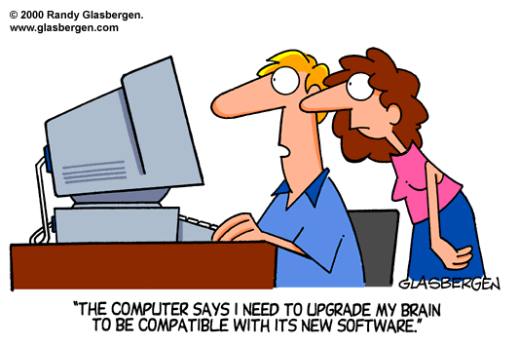
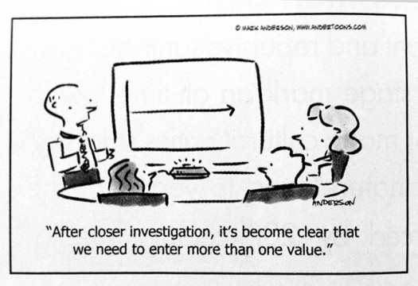
The “Why NOT” for CompTIA
Notes:
Development- Extended Timeline for development, higher number of revisions, more fixed forms for beta testing.
Delivery- Channel upgrades, translations
Analysis- custom data tools, longer complicated analysis due to data capture.
The purpose of using innovative items should be very clear. Your ROI might be comparable if the PBT is successful but if not planned it will be a budget buster and result in extended project schedules.
What is the ROI compared to Text based items.

Slide 6
Where do we begin?
Item Idea
Vendor
Review 1st draft
Vendor
Review 2nd draft/time
Vendor
Beta test/feedback
Vendor
Live Test

Slide 7
Item Process
Item Idea
Select appropriate objectives based on taxonomy and weighting
Group brainstorm and idea development
Propose idea to entire group
Revise idea and incorrect paths
Propose new or adjusted idea to entire group

Slide 8
Item Specification Sheet

Slide 9
Item Details
What is the rationale behind the item?
What should the initial start point of the item look like?
Are there any special environment instructions?
Is anything different from real life?
Can multiple objectives be referenced?
Should the instructions be embedded in the graphic or just in the stem?

Slide 10
Item Details – spec sheet

Slide 11
Correct/Incorrect Details
Correct Paths:
Map out the multiple correct paths (in order, if it is important).
If you find you have too many correct paths, add more criteria/requirements to the stem.
You do not want to make the item too large.
Incorrect Paths:
Should it appear as a correct path?
How many distracter paths are necessary for the item?

Slide 12
Item Details – spec sheet

Slide 13
Item Details – spec sheet

Slide 14
Item Details - Scoring
How many points are appropriate?
Does each point contain several steps?
If so, how are you tracking these steps?
Do you have different levels of score points?
Should you take away points for certain tasks?

Slide 15
Item Details – spec sheet

Slide 16
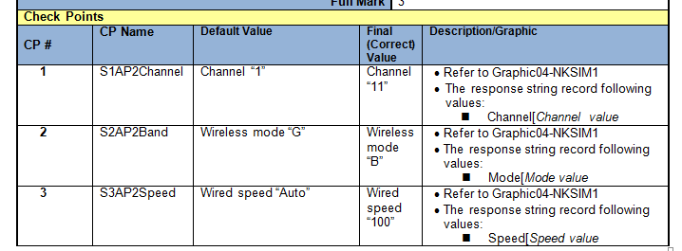
Item Details – spec sheet

Slide 17
Process: Review Phases
Core SMEs review items with no directions to confirm the candidate’s experience / scoring
Compile notes of what works and areas of improvement
Review all expert feedback and implement final feedback with development vendor.
Time and responses recorded on second draft in order to seed.

Slide 18
Process: Beta/Test Feedback
Collect candidate comments and statistics
Discuss findings with core SME group and psychometrician
Revise item if needed
Roll out to live test forms as scored item

Slide 19
Process: Live Test
Balance scored and unscored simulations by time data and estimates for all forms
Balance points and objective areas
Fixed unscored simulations vs. unfixed unscored simulations
Acceptable performance based items can become multiple versions

Slide 20
Response Data
S1HostA|Router[PC[0.0.0.0;
S2HostB|Switch3[Switch4[Switch5[Switch6[1.2.3.4;
S3HostC|Printer[Virus[Malware[2.2.2.2;
~S1|1.5[1;
S2|3.2[3;
S3|1.5[1;
~Score|5
Delimiters:
These are critical to analyzing a response and to tweak items where necessary. Make sure you choose delimiters that will not be used during the exam.
Notes:
When planning response data? Here is what you need to ask yourself: What data points do you want to capture? Do you have enough response data to analyze what candidates are doing during the beta process? Are you sure that you did not miss any possible correct paths? Do all the distracter paths function or are paths not being used? Is the scoring working as expected? Is the item taking too long or is it too difficult?
Delimiters: | separates key and value (meaningful name and response data) [ separates values; ; separates one full response string from the next, ~ separates the scoring from the responses (child from parent score).

Slide 21
Psychometric Considerations
Why include simulations?
Validity
Cognitive complexity
Mitigate security issues
Can take a lot of valuable time
Can be good or bad, just like MC
Need to be analyzed and evaluated
Proper data need to be collected
Use a consistent data format
Use delimiters that can’t otherwise be used

Slide 22
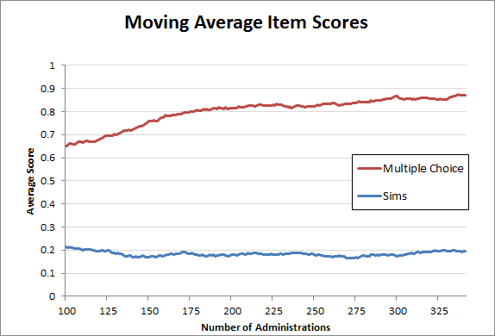
Psychometric Considerations
Notes:
2 observations… Sims are more difficult… and more stable

Slide 23
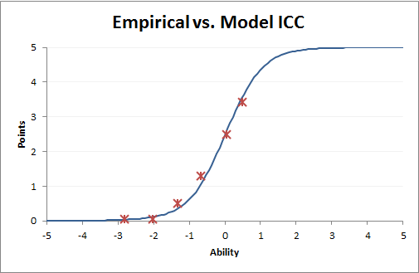
Sample SIM Analysis
Parent/child overall points
Possible Points | 5
Scoring Opportunities | 3 (worth 1, 2, & 2 points)
Average Item Score | 1.81
Item-Score Correlation | .46
Median Response Time | 355 seconds
Notes:
But are they measuring the right people and skills?

Slide 24
Sample SIM Analysis
 | p-value | correlation | avg. time
ScoreOpp1 | 0.438 | 0.475 | 147
ScoreOpp2 | 0.384 | 0.314 | 159
ScoreOpp3 | 0.301 | 0.293 | 129
ScoreOpp1 | option | p-value | correlation | avg. time | 12 to 49 | 50 to 60 | 61 to 68 | 69 to 74 | 75 to 92
 | S2Server|A | 0.014 | -0.112 | 312 | 1
 | S2Server|B | 0.014 | -0.140 | 215 | 1
 | S2Server|C | 0.041 | -0.063 | 147 | 1 | 1 |  |  | 1
 | S2Server|D | 0.014 | 0.098 | 100 |  |  |  | 1
 | S2Server|H1 | 0.192 | -0.083 | 163 | 5 | 3 | 1 | 5
> | S2Server|H2 | 0.438 | 0.475 | 147 | 3 | 5 | 7 | 7 | 10
 | S2Server|H3 | 0.041 | -0.176 | 225 | 2 | 1
 | S2Server|H4 | 0.055 | -0.206 | 111 | 2 | 2
 | S2Server|H5 | 0.014 | -0.021 | 77 |  | 1
 | S2Server|H6 | 0.110 | -0.194 | 151 | 5 | 1 | 1 |  | 1
 | S2Server|null | 0.068 | -0.111 | 82 | 2 | 1 | 1 | 1
Scoring opportunities 2 and 3 have similar analyses.

Slide 25
Sample SIM Analysis
SIM21 | Points | p-value | correlation | avg. time | 12 to 49 | 50 to 60 | 61 to 68 | 69 to 74 | 75 to 92
 | 00-zero | 0.428 | -0.200 | 328 | 38 | 23 | 37 | 40 | 8
 | 01-one | 0.152 | -0.100 | 407 | 14 | 12 | 11 | 10 | 5
 | 02-two | 0.100 | -0.019 | 304 | 8 | 8 | 6 | 5 | 7
 | 03-three | 0.196 | 0.154 | 381 | 9 | 13 | 8 | 13 | 24
 | 04-four | 0.003 | -0.048 | 190 | 1
 | 05-five | 0.120 | 0.253 | 338 | 1 | 10 | 6 | 4 | 20
SIM21 | option | p-value | correlation | avg. time | 12 to 49 | 50 to 60 | 61 to 68 | 69 to 74 | 75 to 92
5 | "<response status=""… | 0.137 | 0.283 | 350 | 1 |  | 1 | 3 | 5
4 | "<response status=""… | 0.014 | 0.071 | 385 |  |  |  | 1
3 | "<response status=""… | 0.014 | -0.048 | 252 |  | 1
3 | "<response status=""… | 0.014 | 0.062 | 345 |  |  |  | 1
3 | "<response status=""… | 0.014 | 0.272 | 808 |  |  |  |  | 1
3 | "<response status=""… | 0.027 | 0.211 | 376 |  |  | 1 |  | 1
3 | "<response status=""… | 0.014 | 0.043 | 327 |  |  | 1
3 | "<response status=""… | 0.110 | 0.119 | 379 | 2 | 1 |  | 3 | 2
3 | "<response status=""… | 0.027 | -0.016 | 658 |  | 1 | 1
2 | "<response status=""… | 0.014 | -0.167 | 335 | 1
… and so on for 3 dozen more rows.

Slide 26
Lessons Learned
Plan response data during the initial draft phase (i.e. correct/ incorrect response samples).
Communicate with all vendors and stakeholders before starting your performance based items.
Realize this is a lengthy time consuming process.
Do NOT make multiple versions of an item until it is in a final acceptable state.
Revisit scoring-All or nothing vs. partial.
Translations create new challenges.

Slide 27
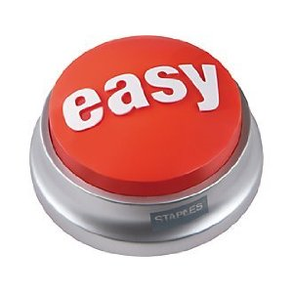
Questions?

